Slide 1

TechHighway
TechHighway

Slide 2

What is the TechHighway ?
TechHighway is a public utility application which aims to solve the general problems faced by people during their daily bases .
By collecting data from user and several datasets , which make a better optimizer search result for tracking the obstacles occurred or may occur within a track .
Also it aims to provide a clear image of all the hurdles that cause issue that may disrupt the ride as the user sets the destination.

Slide 3

Our Aim At TechHighway
Notified Potholes
Women Safety
Depict Condition of roads
Polluted Area
Flood Area

Slide 4


Women Safety

Slide 5
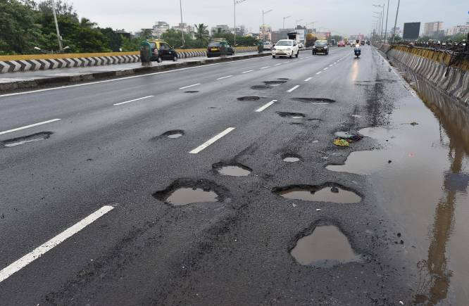
Notified Potholes

Slide 6
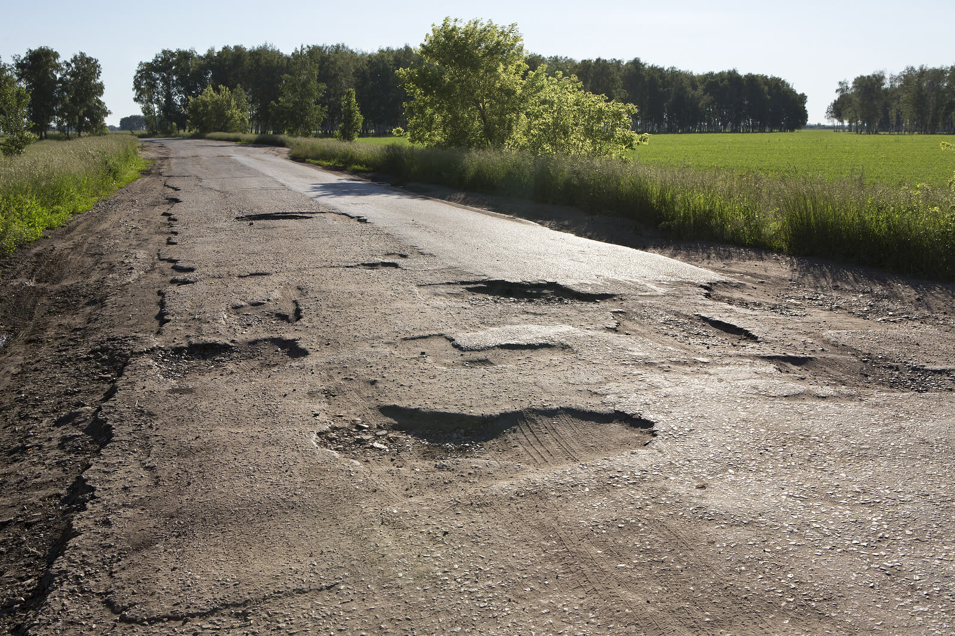
Depict Condition of Roads

Slide 7
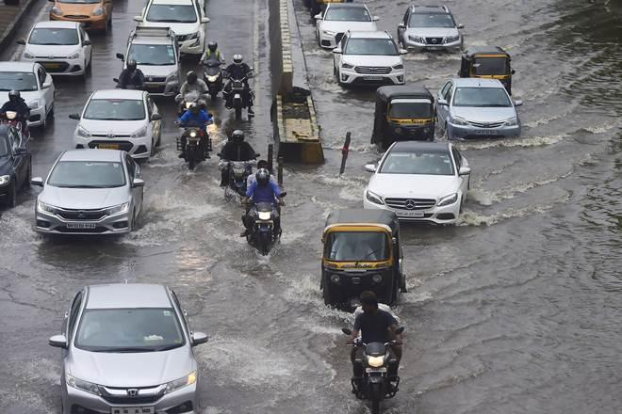
Flood Area

Slide 8

How We Work ?
Collecting data from users.
Collecting the data from municipal Corporation.
Sending notification to the users.
Knowing the user about the problems.

Slide 9


